Slide 1
Test Driven Development In Action!
by Jon Kruger
Notes:
Not going to teach you everything about TDD in one hour
Going to try to show you how to think test-first and why you should do TDD
Agile is about expecting and planning for change – TDD will enable us to succeed
I’m going to show you how to do this in .NET, but I’m not trying to teach the frameworks as much as I’m trying to teach you a new way of thinking

Slide 2
What is Test Driven Development?
A software development technique where you write automated unit tests before you write your implementation code
A technique for ensuring good quality and good design
Awesome!

Slide 3
Example of a unit test
[TestFixture]
public class When_using_the_calculator
{
[Test]
public void Should_add_two_numbers()
{
int result = new Calculator().Add(2, 3);
result.ShouldEqual(5);
}
}

Slide 4
Unit Tests vs. Integration Tests
Unit tests:
Tests a small unit of functionality
Mock or “fake out” external dependencies (e.g. databases)
Run fast
Integration tests:
Test the whole system working together
Can run slow
Can be brittle

Slide 5
Unit Testing Frameworks
.NET
NUnit, MSTest, MBUnit, xUnit, MSpec
Java
JUnit, TestNG
Ruby
RSpec, Test::Unit, Shoulda

Slide 6
The TDD Process
Write a test (or tests) for something. Since you haven’t written the implementation code yet, the tests should fail.
Write just enough code to get the test to pass.
Move on or refactor
“Red – Green – Refactor”

Slide 7
A Series of Translations
Notes:
What do you do when you get a feature? Do you start drawing database diagrams on the whiteboard? How can we best write our code while keeping the business functionality in mind?
The goal is to preserve the original intentions of the business.

Slide 8
Code!

Slide 9
?

Slide 10
Benefits of TDD
We know that our code is working!
Notes:
-Lower stress level!
-Not wasting time setting breakpoints and testing the debugger

Slide 11
Benefits of TDD
We know that our code will continue to work
Notes:
-If you test with the debugger, how do you know the next day if your code is still working?
-Someone else is going to change your code someday, so now you don’t have to worry about them breaking your stuff.

Slide 12
Benefits of TDD
We didn’t write bugs
Notes:
Bugs cost money to find, money to write up, money to fix
The negative impact caused by bugs can be really expensive

Slide 13
Benefits of TDD
We know when we are done

Slide 14
Benefits of TDD
We incrementally translated the requirements

Slide 15
Behavior Driven Development
Testing the behavior of the system (not just data returned by a method)
Defining what it means for your system to work correctly (not just verifying that code works)
Notes:
Software development is a series of translations – we need to get from an idea in someone’s head to working software. The best way to not lose sight of that goal is to do small “translations” that will ensure that we stay focused on the original goal.

Slide 16
Benefits of TDD
Concentrate on the requirements/tests, then concentrate on implementation
Notes:
-Think about one thing at a time… much easier, less stressful

Slide 17
Benefits of TDD
We only wrote as much code as we needed to make the tests pass
Notes:
We won’t waste time on code that we don’t need to write
Helps prevent gold plating

Slide 18
Benefits of TDD
Our tests helped us design our code
Notes:
-When you write testable code, you are less likely to have tight coupling
-Our tests help us name our methods well

Slide 19
“Clean code that works is the goal of Test Driven Development.”
-- Ron Jeffries

Slide 20
Benefits of TDD
We had to write testable code
Notes:
-If you write your tests after your implementation code, you might end up with a situation where it’s difficult to test it

Slide 21
Benefits of TDD
We couldn’t cheat and not write the tests
Notes:
If you test after, you might forget or just get lazy.

Slide 22
Benefits of TDD
Our tests are documentation of what our code does

Slide 23
Benefits of TDD
Our tests are documentation of what our code does
Someday someone other than you will have to understand your code
Someday you will wonder what your code was supposed to do
Living, breathing documentation!

Slide 24
Benefits of TDD
We can quickly regression test our code

Slide 25
Benefits of TDD
We can quickly regression test our code
Fewer bugs
Able to release more often
Less time spent doing manual testing
Prevent our app from becoming “legacy code”
Notes:
My definiton of legacy code: Code where the cost or risk associated with changing it outweighs the benefits of the change.

Slide 26
Benefits of TDD
Peace of mind!
Notes:
I can’t explain this one, you have to experience it for yourself!

Slide 27
A TDD Success Story

Slide 28
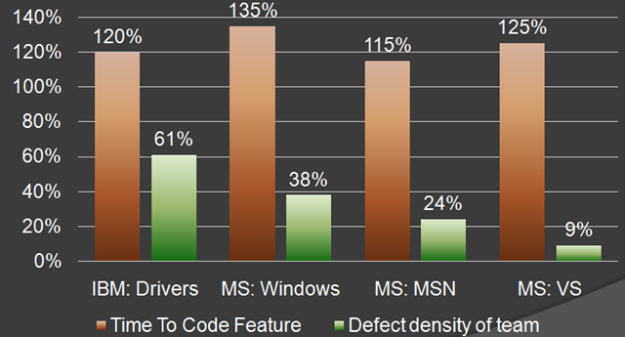
The Cost of Unit Testing
Source: http://blog.typemock.com/2009/03/cost-of-test-driven-development.html

Slide 29
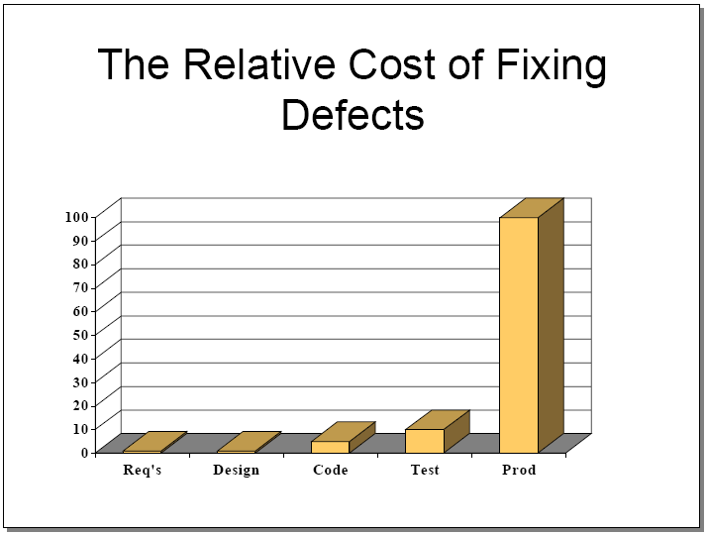
The Cost of Not Unit Testing
Source: http://www.riceconsulting.com/public_pdf/STBC-WM.pdf

Slide 30
But I don’t have time to do TDD!
I don’t have time to fix bugs
I don’t have time to constantly manually test code to see if it’s all working
I don’t have time to figure out what your code is supposed to do
I don’t have time to figure out if my changes will break something in your code
I don’t have time to rewrite code
Think long-term, not short-term!!

Slide 31
“If I don't need to make it work, I can go a lot faster.”
-- Kent Beck

Slide 32
This is my story
Notes:
This is not about dogmatism or people who you think are smarter than you, it’s about finding a better way to do software development.
Ask anyone who practices TDD, and they will all tell you that they would never go back to the old way.

Slide 33
?

Slide 34
Resources - Cost of unit testing
Microsoft Research – “Realizing quality improvement through test driven development: results and experiences of four industrial teams”
http://research.microsoft.com/en-us/projects/esm/nagappan_tdd.pdf
Cost of Testing, by Misko Hevery (Agile Coach/Java developer at Google)
http://misko.hevery.com/2009/10/01/cost-of-testing/
TDD Derangement Syndrome, by Uncle Bob Martin
http://blog.objectmentor.com/articles/2009/10/07/tdd-derangement-syndrome

Slide 35
Resources - Tools
.NET
NUnit – http://nunit.org
Should – http://should.codeplex.com
Java
JUnit – http://junit.org
TestNG – http://testng.org
Ruby
RSpec – http://rspec.info, or gem install rspec
Specs2Tests – http://github.com/jonkruger/specs2tests

Slide 36
Resources – Learning TDD
Behavior Driven Development
http://www.code-magazine.com/article.aspx?quickid=0805061&page=1
So How do You Introduce TDD into an Organization or Team?, by Jeremy Miller
http://codebetter.com/blogs/jeremy.miller/archive/2006/06/27/146899.aspx
How to get started with TDD, by Misko Hevery (Java examples)
http://misko.hevery.com/2009/11/17/how-to-get-started-with-tdd/
TDD Starter Kit – Sample Projects and Links (C# examples)
http://jonkruger.com/blog/2009/07/23/tdd-starter-kit-sample-projects-and-links/
Pair Programming Bot
http://pairprogrammingbot.com/

Slide 37
Resources – Books
The Art of Unit Testing
by Roy Osherove
Test Driven Development: By Example
by Kent Beck
Test Driven Development: A Practical Guide
by David Astels
The RSpec Book: Behaviour Driven Development with RSpec, Cucumber, and Friends
by David Chelimsky, Dave Astels, et. al.

Slide 38
Resources – Practice!
String Calculator kata
http://osherove.com/tdd-kata-1/
Bowling Game kata
http://butunclebob.com/ArticleS.UncleBob.TheBowlingGameKata
Prime Factors kata
http://www.butunclebob.com/ArticleS.UncleBob.ThePrimeFactorsKata
Greed game (part of the Ruby koans)
http://github.com/edgecase/ruby_koans
Katacasts (watch screencasts of people doing various katas)
http://www.katacasts.com/

Slide 39
Resources – Training
TDD Boot Camp (.NET)
http://tddbootcamp.com
Cincinnati – June 22-24
Columbus – July 13-15
Detroit – Aug. 18-20
Pillar Technology (Java)
http://pillartechnology.com
EdgeCase (Ruby on Rails)
http://edgecase.com

Slide 40
My Info
Email: jon@jonkruger.com
Twitter: @JonKruger
Blog: http://jonkruger.com/blog
These slides: http://tinyurl.com/tdd-in-action
Code: http://github.com/jonkruger/tdd-in-action

